Slide 1

ChoreHero
By team baja (ben siao, alex orban, joe norton, allen jiang)

Slide 2
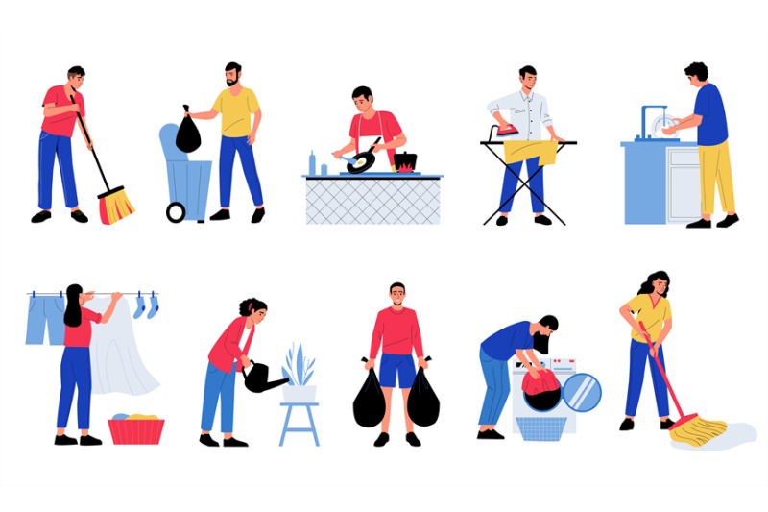
Introduction
For our project, we developed a Chores Web App designed to manage household chores efficiently. The application allows family members to assign, track, and complete tasks through a user-friendly web interface.
Used HTML for the front-end layout, PHP for server-side logic and user interactions, and MySQL to manage the backend database. The system is hosted on a MAMP server during development and testing.
Key features of the app include chore assignment, search functionality by user ID or name, and a rewards or scoring system to incentivize task completion.
To align with project requirements, we followed the Waterfall Model for our development process, ensuring a clear and structured progression through each project phase.

Slide 3
Requirements of each function
Requirement 1: Add Chores-Users can add a new chore with details such as name and deadline. The chore is stored in the database and displayed on the app’s main page.
Requirement 2: Edit and Delete Chores-Users can modify or delete tasks. Edits update the chore details, while deletions permanently remove them from the database.
Requirement 3: Chore Status Update-Users can mark chores as completed, and the system updates the chore’s status while awarding points.
Requirement 4: Assign Chores-Administrators assign chores to specific users, logging them in the database with user details.
Requirement 5: Search Functionality -Users can search for chores by name, and the system retrieves relevant tasks based on the query.
Requirement 6: Rewards System-The system tracks completed chores, awards points, and lets users view and redeem rewards.
Requirement 7: User Management-Administrators can add, edit, or remove user profiles, while users can update their personal details.

Slide 4

Database Description
The database contains three tables, which are explained in the data structure:
Family table
Contain all the information about the family, such as the users in the family and their corresponding reward system. The table also stores the users' log-in information, such as email and password.
Chore Table
Contain ChoreID (chore unique specifier), UID (user ID foreign key), RID (rewardID foriegn key), description (the chore description), CName (chore name), date completed, and chore status.
Reward Table
Contain RewardID (which is the unique identifier for the reward), rewardName, CID, UID, and reward point, which specifies the reward point for the chore completed.

Slide 5
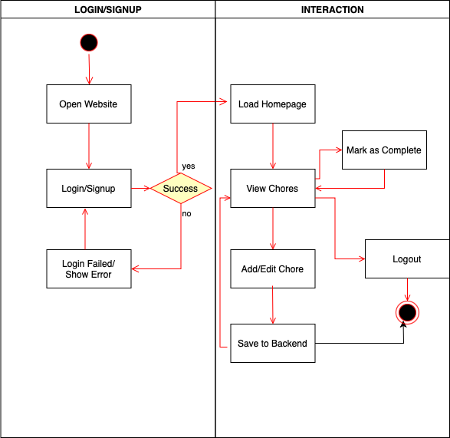
Interaction
Activity Diagrams UML
Interactions:
User requests a page (e.g., chore list)
Server retrieves data from the MySQL database
Server sends rendered HTML back to the client
User submits updates (e.g., marks chore as complete), which are sent back to the server for processing

Slide 6
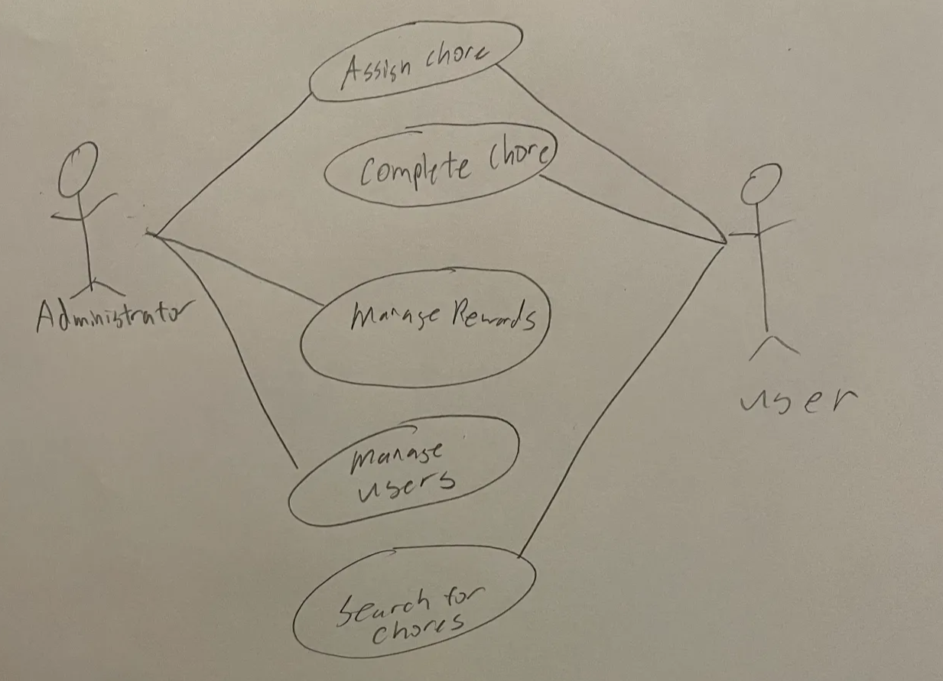
Use Case Model
- Assigning a chore: all users can do this. However, we could change it to admin roles only in the future for security purposes. This use case involves assigning a user a chore. The details of the chore will be assigned including the name and a deadline.
- Complete chore is where a chore is marked as completed. This will be done by the user when they mark each chore as complete. This changes the status of the database to “complete” when the chore is completed.
- The administrator will do management rewards to compute the points for each specific chore and tracks each user to how many reward points they have based on the number of chores completed.
- Managing users is done by the admin (the user with database access) who can remove new users, remove user accounts. They can also modify each user’s accounts.
- Searching for chores is done by the user to see what chores need to be completed. Chores show up after assigning them.

Slide 7

Development Process
Requirements Analysis and Definition We identified and documented the app’s core features which included chore assignment, user tracking, and rewards. These were based on team discussions and user needs.
System and Software Design We designed a client-server architecture using MVC principles, outlining how the frontend, backend, and database would interact.
Implementation and Unit Testing Each module was developed and tested individually, including chore creation, user login, and point tracking functionalities.
Integration and System Testing All components were combined and tested as a complete system to ensure they met the project requirements and worked seamlessly.
Operation and Maintenance We prepared the app for future use and updates by documenting setup steps and planning for usability and feature enhancements.

Slide 8
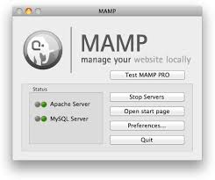

Test Plan
Software Tested:
Database storing user and task information
PHP backend scripts used to process user actions and communication between components
Testing Tools and Environment
MAMP was the local server setup
PhpMyAdmin for database creation, management and verification
Ensured functionality worked on many web browsers like Google Chrome, Firefox and Microsoft Edge
Manual testing methods were also used to verify behavior
Frontend pages created with HTML, CSS, and JavaScript

Slide 9
Test Cases
Case 1 - User registration functionality – Ensures user account details are added to the database and login in successfully
Case 2 - Validation and error handling for registration – Error message displayed if invalid credentials are used
Case 3 - Successful user login – Existing account data is retrieved successfully
Case 4 - Login error handling for invalid inputs – Error message displayed if credentials do not match with existing accounts
Case 5 - Adding a task to the system successfully – Task added to task list successfully and appears on the user interface
Case 6 - Deletion of an existing task – Selected task is removed from the database and does not appear on the user interface

Slide 10
Test Cases
Case 7 - Viewing user tasks – All tasks are shown in the user interface and exists in the database
Case 8 - Retrieval and display of user account names – Names of all registered users are displayed correctly
Case 9 - Form validation for task creation – Error message displayed if fields invalid during task creation
Case 10 - Marking a task as complete and updating score – Task status changed to "complete" and score increases
Case 11 - Cumulative score updating after multiple task completions – Score increases according to number of completed tasks

Slide 11
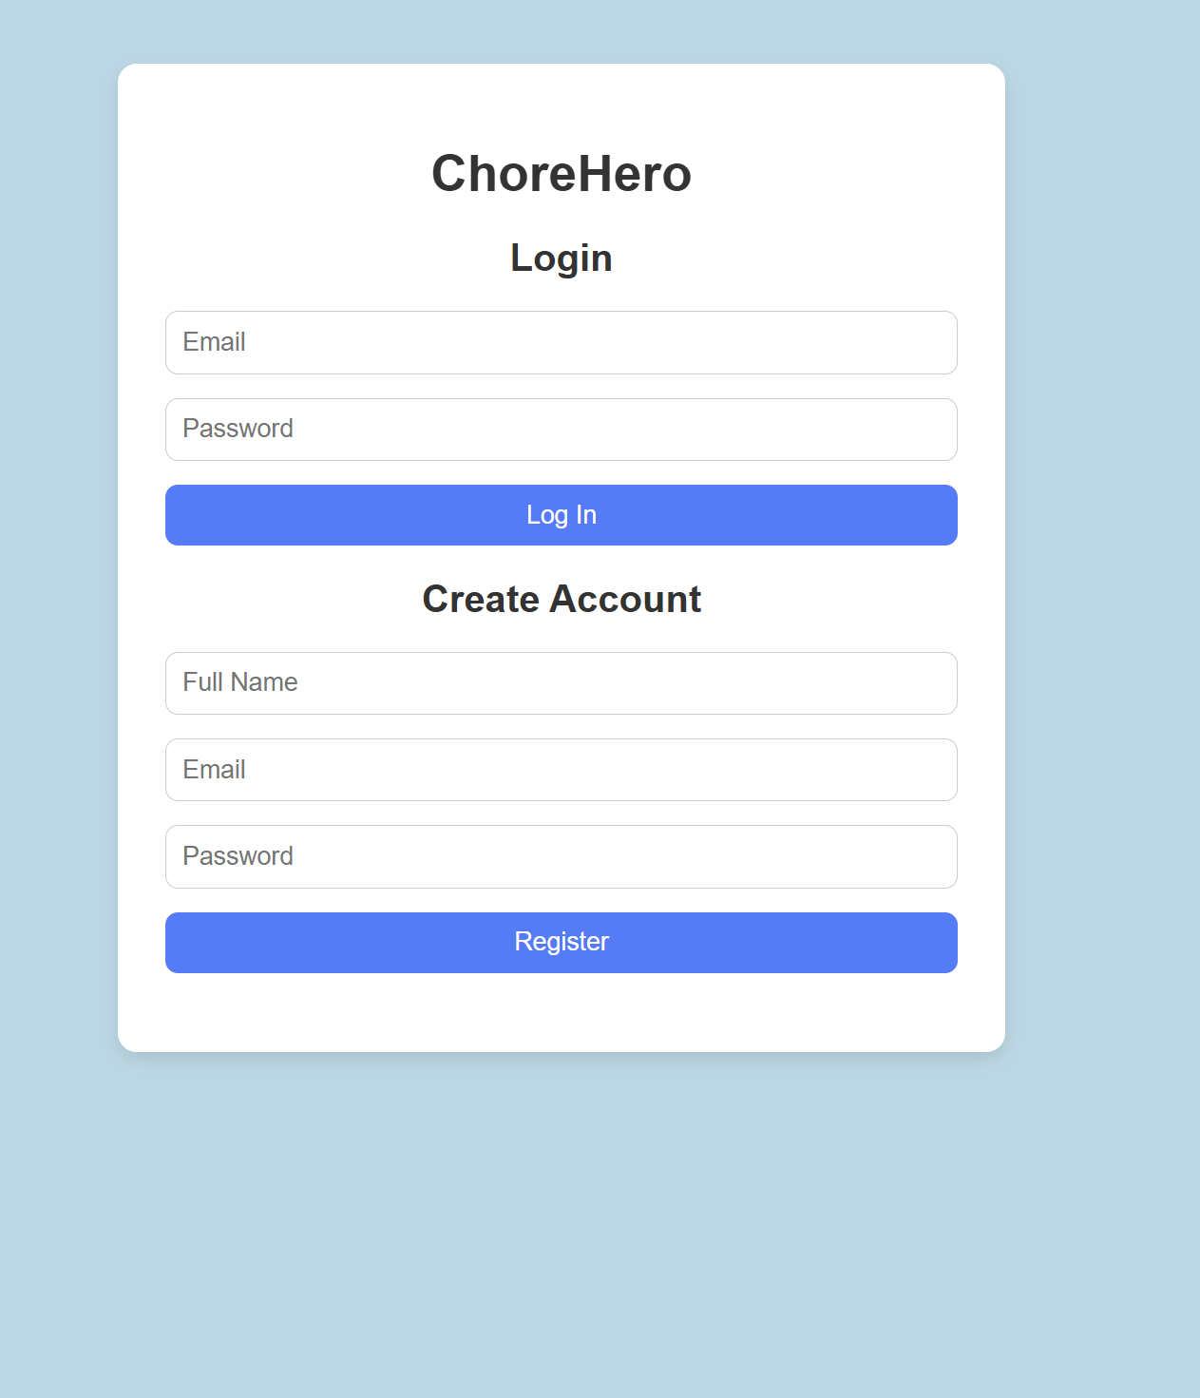
How It Looks

Slide 12
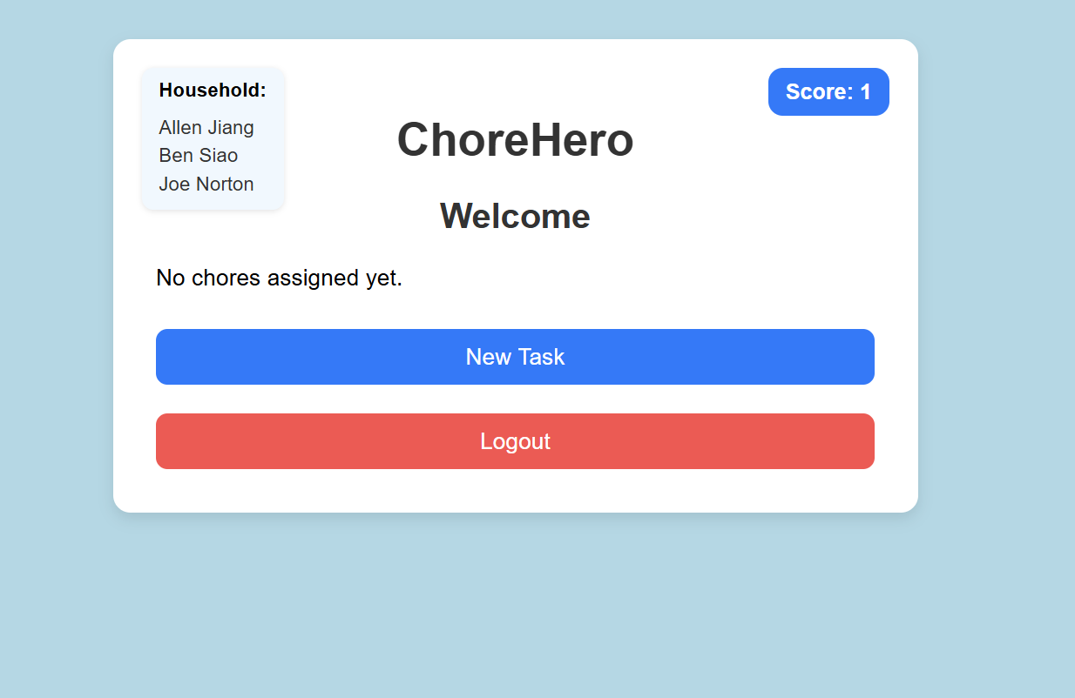
After Logging In

Slide 13

DEMO
http://localhost/ChoreHero/
http://localhost/phpMyAdmin5/index.php?route=/sql&server=1&db=chore_app&table=household&pos=0

